Slide 1
SEVIS 101: SEVIS & Financial Evaluations
Graduate College Admissions & Enrollment
2026 Admissions Cycle

Slide 2
Workshop Agenda
Introduction to SEVIS & International Student Visas
Funding Requirements
The SEVIS Evaluation Process
The Post I-20 Steps
Graduate College

Slide 3
Introduction to SEVIS & Visas
Graduate College

Slide 4
What is SEVIS?
Student and Exchange Visitor Information System
Federal electronic database that houses immigration information for international students
Access is restricted to authorized users:
Designated School Official (DSO)
Alternate Responsible Officer (ARO)
Graduate College

Slide 5
What is an I-20? DS-2019?
An I-20 or DS-2019 is a paper document issued to international students seeking to enter the U.S. to study with a student status.
The issuing of the I-20/DS-2019 creates the student’s online SEVIS record & ID.
These documents are referred to as visa eligibility documents and allow for students to apply for student entry visas (F or J visas).
Types of Visa Eligibility Documents
Initial – Does not have a current SEVIS record
Transfer – Coming from another U.S. institution
Change of Level – Current Illinois student with an active SEVIS record
Change of Status – Changing visa status within the U.S. (not traveling abroad/home)
Graduate College

Slide 6
What is visa?
Student visas permit the students to enter the US to study
F-1 Student Visa (F-2 Dependent) = I-20
Most common type you will see
J-1 Student Visa (J-2 Dependent) = DS-2019
Other common visa types:
J-1 Scholar Visa
H-1 Work Visa (H-4 Dependent)
B-1 Business/B-2 Tourist Visa (not allowed to study)
Graduate College

Slide 7
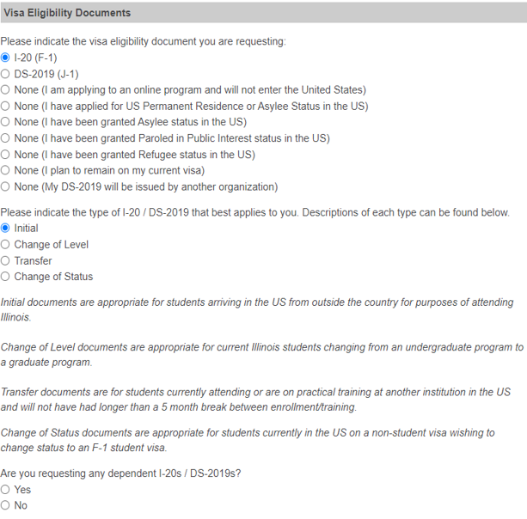
Application: Residency Information
Graduate College

Slide 8
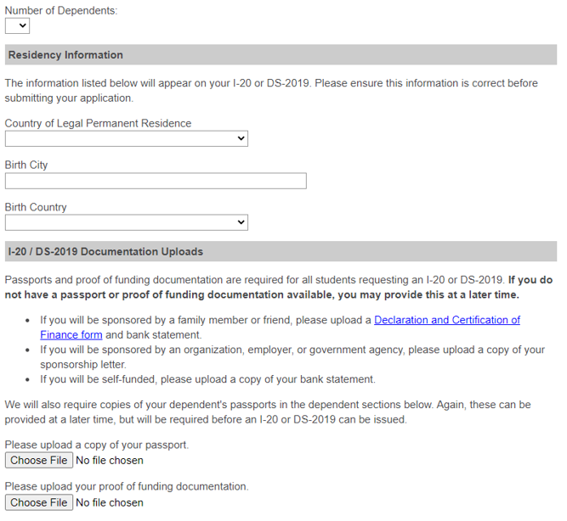
Application: Residency Information (cont.)
Graduate College

Slide 9
Financial Evaluations
Graduate College

Slide 10
Financial Evaluation Basics
Who is required to provide proof of funding?
Any international applicant or re-entry requesting either an I-20 or DS-2019
Why is proof of funding required?
Federal regulations require that prospective students provide proof that they have the financial resources to live and study in the United States.
What documentation must be provided as proof of funding?
F-1 applicants must verify proof of liquid funds for the total cost of the first year of study by submitting bank statements and/or sponsorship documentation as appropriate.
J-1 applicants must verify proof of funding for the full length and cost of the program.
51% or more of J-1 applicants’ funding must be from government, organization or department funding.
Graduate College

Slide 11
Funding Documentation
All documents must be in English or a certified English translation and issued less than one year before the Graduate College receives admission referral
Bank statements must list bank name, the account holder’s name, and show actual current balance for liquid funds
Declaration of Finance Forms and Letters of Sponsorship from individuals must include the sponsor’s printed name and physical signature
Letters of Sponsorship from organizations must be on the organization’s letterhead and include an official signature, stamp or seal
Solvency and/or capability statements are not acceptable
Statements from accounting or financial advising firms are not acceptable
Graduate College

Slide 12
Funding Accounts
Acceptable
Unacceptable
Checking, savings, deposit/time deposit
Post office funds
Accounts tied to the prime rate (Money Market)
CDs, Installment CDs, Installment Savings
Trust Funds (discretionary funds only), Provident Funds (current withdrawable amount)
Pensions (only when statement included that they are allowed to withdraw without penalty)
Student loans
Lines of credit
Proof of employment or paystubs
Investment accounts, securities, mutual funds, stocks, bonds
General trust funds
Insurance premiums/policies
Land/car titles
Graduate College

Slide 13
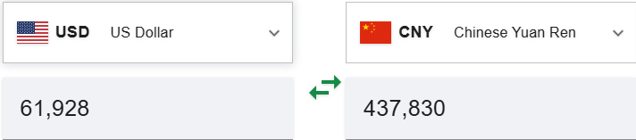
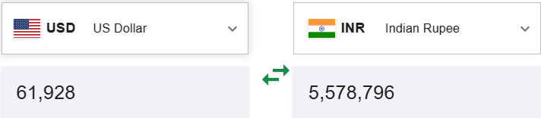
Converting Funds
Documents are not required to be in USD
We will convert at rate of day reviewed: xe.com or oanda.com
Graduate College

Slide 14
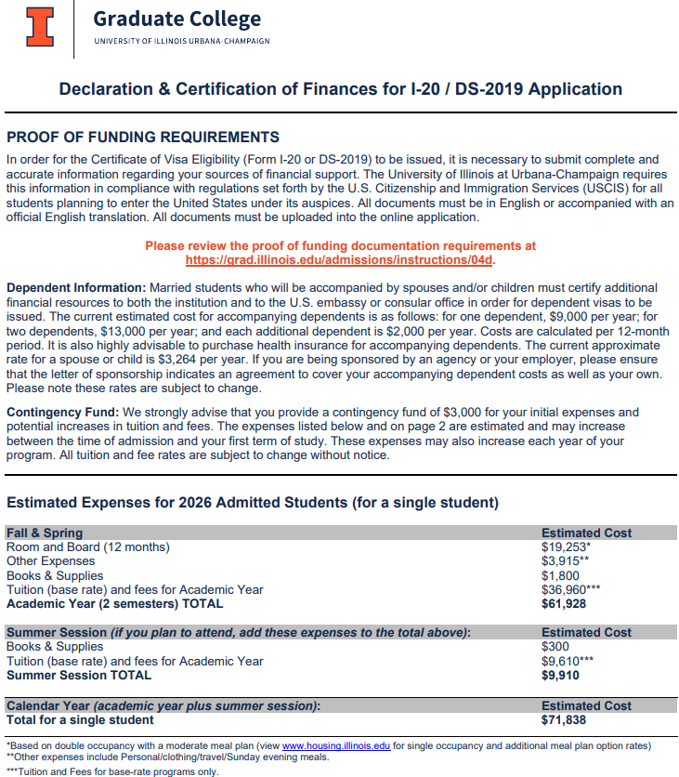
Declaration & Certification of Finance Form: Page 1
Graduate College

Slide 15
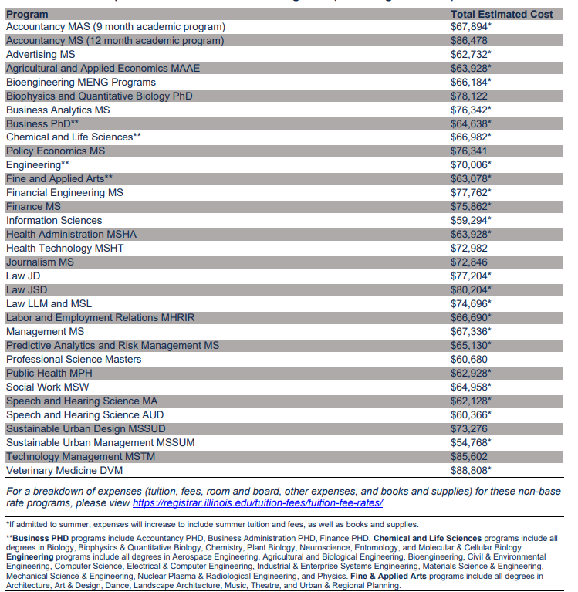
Declaration & Certification of Finances Form: Page 2
Graduate College

Slide 16
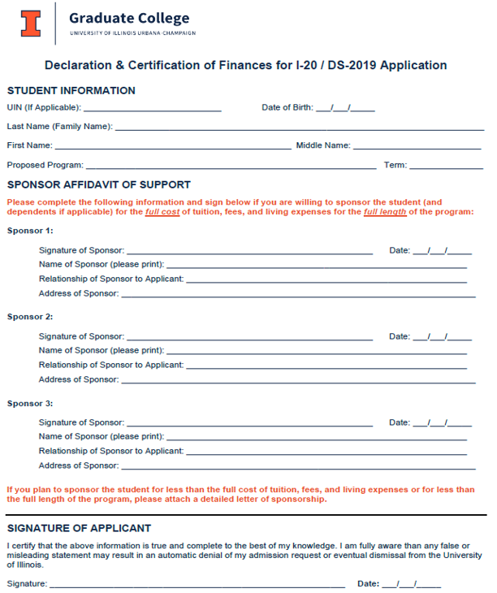
Declaration & Certification of Finances Form: Page 3
Graduate College

Slide 17
Funding Types
Graduate College

Slide 18
Departmental Funding
Types:
Assistantships, Fellowships, Scholarships, Stand-Alone Tuition Waivers
Information Required:
All Types: Annual Stipend and Terms Included
Add’l Info for Assistantships: Appointment Percentage
J-1 Students: Need confirmation if appointment is renewable for entire length of program – We have added a Yes/No option so you no longer need to type in the comments
Other Funding:
We have added a text box where you can add other funding coming from the university
Graduate College

Slide 19
2026 Tuition Waiver Amounts
Tuition Waivers as Part of an Assistantship or Fellowship (Base Rate Programs):
Fall/Spring Tuition Waiver: $35,888
Fall/Spring/Summer Tuition Waiver: $45,129
Costs covered include: base tuition, service fee, health service fee, health insurance add-in, AFMFA fee, library fee
Stand-Alone Tuition Waivers (Base Rate Programs):
Fall/Spring Tuition Waiver: $33,196
Fall/Spring/Summer Tuition Waiver: $41,257
Minimum Stipends:
To cover full cost of a base rate, Engineering or Chem/Life Sciences program for Fall/Spring admits (with no dependents), the stipend must be at least $26,040.
Graduate College

Slide 20
Organization Funding
Types:
Government, University, Employer, Other Business
Documentation Requirement:
Signed Letter of Sponsorship
Letter must be printed on the organization’s letterhead with an official stamp and/or signature
Letters must include sponsorship details (amount and length of sponsorship)
Bank statements are NOT required for organization funding
However, if provided, they will be reviewed
Declaration of Finance forms are NOT accepted, we must have the Letter of Sponsorship
Graduate College

Slide 21
Personal Funding
The applicant will be sponsoring him/herself
Can use as many bank accounts as needed
Documentation Requirements:
Bank Statement(s):
Statements must be in English or accompanied by a certified English translation
We need to be able to confirm the account type, current balance, bank name & account holder’s name
Statement must be dated within 1 year of the admission referral
Funds should be available by start of term
Declaration of Finance Form is NOT required for personal funds
Graduate College

Slide 22
Family and Sponsor Funding
Relatives, very generous friends or if relationship is unknown
An applicant can have as many sponsors with as many bank statements as needed to cover the total expenses
Documentation Requirements:
Bank Statement(s):
Statements must be in English or accompanied by a certified English translation
Statement must be dated within 1 year of the admission referral
Funds should be available by start of term
Declaration of Finance Form or Letter of Sponsorship
Document must include the printed & hand-signed signature of each sponsor
Letters must include sponsorship details (covering full expenses or a specific amount)
Note on Family Business Sponsorships: Need sponsorship letter from the business (on company letterhead), even if business is owned by student’s family member/sponsor. These are considered organization funding.
Graduate College

Slide 23
Evaluation Complete
Graduate College

Slide 24
SEVIS Process Incomplete Notification
If any required documents are missing or unacceptable, an email will be sent to the department only detailing what is needed:
No passport, no dependent passport, no funding documentation, no declaration of finance form, short funding, no country of citizenship address and/or other – see comments
The student can upload additional documents to their admissions status page and notify the department or grad@illinois.edu when available
Any department funding changes or new uploads, please email grad@Illinois.edu to review.
Graduate College

Slide 25
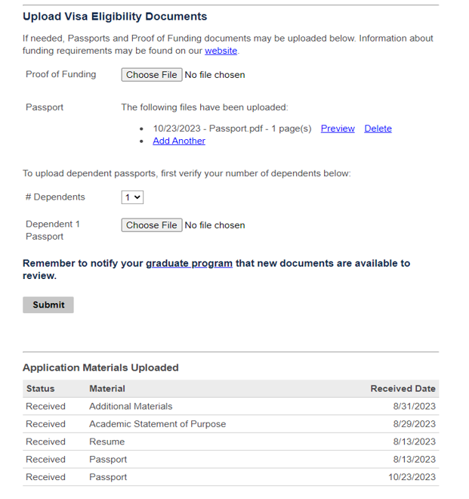
Admissions Status Page
Graduate College

Slide 26
SEVIS Process Complete Notifications
Initial, Change of Levels or Change of Status
An email will go out to the student and department contact with a link to their admissions status page to print their I-20.
This email will also include directions for next actions to take for the student.
Transfers
These students’ email will include directions to request a SEVIS transfer with their current university’s international student office.
After their SEVIS record has been transferred to Illinois, we will be able to issue the visa eligibility document. A new email with a link to their status page will go out once the document has been issued.
Graduate College

Slide 27
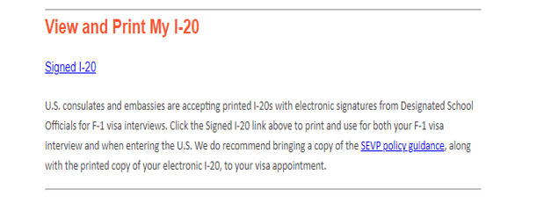
Admissions Status Page
Students can only view most recent I-20/DS-2019
I-20s/DS-2019s will only be delivered electronically
Graduate College

Slide 28
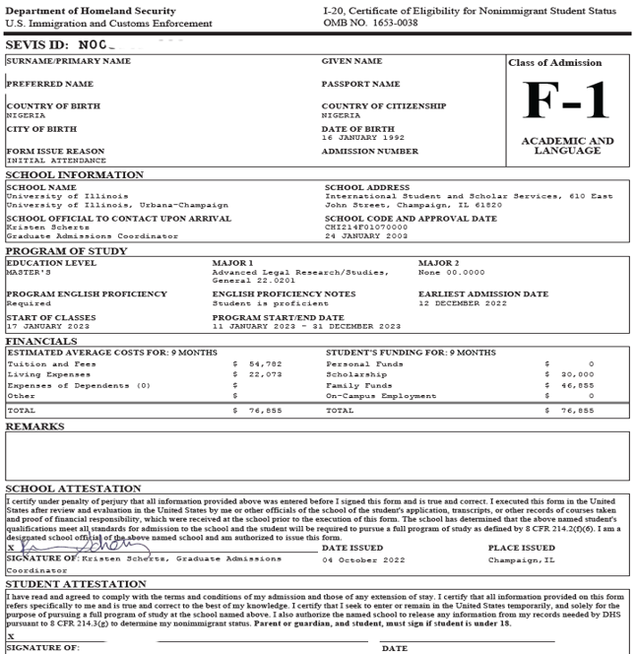
Sample I-20
Graduate College

Slide 29
Initial Student Next Steps
Please pay your SEVIS fee online at www.fmjfee.com (I-901 fee). Remember to print the receipt to present at your visa interview.
Schedule an appointment for your non-immigrant entry visa: http://www.usembassy.gov/. As you have been issued an initial I-20, you will need to follow this step even if you are currently in the US. Please bring the required documents to your visa interview as listed on the embassy website.
What you will need to show at the United States Port of Entry:
Passport
Entry visa
Printed I-20
You may also be asked to show proof of your funding as listed on your I-20
If you are a Canadian citizen, you will not require an entry visa to enter the United States.
When you arrive on campus, you are required to check in with the International Student and Scholar Services (ISSS) office upon arrival and before class registration. All new international students are required by law to report for check-in with the Office of International Student and Scholar Services (ISSS). Instructions, important dates, and location can be found at: http://go.illinois.edu/Checkin.
Graduate College

Slide 30
Late Arrivals
The Program Start Date is the deadline to arrive in the US
We want students here by 10th day but will review additional time on a case-by-case basis
Late arrival approvals will need to come from the department in order to update the I-20
If visa appointment is after PSD, then we should update I-20 before the appointment
If has visa, then we will need their booked US arrival date
Ensure your student is aware of the challenges of late arrivals
Housing
Transitioning while studying and/or working
OPT qualifications
Tuition refunds, if have to withdraw
Graduate College

Slide 31
FAQs
Who should I direct any I-20/visa questions to?
GC can assist all new and re-entry graduate students
Current graduate students, considered current once they have checked in, can be assisted by ISSS
When will the Transfer I-20 be issued?
The student should choose a release date with their current university and Illinois department. We typically issue the I-20 within a couple of business days from the release date.
Changes were made to a student’s I-20, will the SEVIS ID change?
If they paid their SEVIS fee, any updates to their current I-20 are unlikely to change the SEVIS ID.
A student’s EPT requirement was removed for new test scores, will they need a new I-20?
Students whose admission is updated from limited status to full status will not be issued a new I-20.
Why is there a dash (-) for the student’s first/given name?
If the student has 1 name listed on their passport, it has to be listed as the last name. Banner & Slate require a first name, so a dash will be used. The first name will be left blank on the I-20.
Do you need a copy of a new passport?
We will only need an updated passport if the person’s name has changed or if it is for a new citizenship country.
I am deferring my admission, when will I receive my new I-20?
I-20s cannot be issued until you have submitted the recode for admission and they have officially been admitted to the new term by the Graduate College.
Graduate College

Slide 32
Admissions Resources Toolkit
Offers Guidance & Best Practices for:
Slate
Credential Evaluation
English Proficiency Evaluation
SEVIS & Financial Evaluation
Change of Program & Re-Entry Resources
Admissions Policy & Forms
The Admissions Resources Toolkit can be found on the Graduate College website.
Graduate College

Slide 33
Thank you
Questions?
Graduate College

Slide 34
Upcoming Workshops
January 13 Registration & Enrollment 101
January 22 Slate 103 (Query Building)
February 3 Slate 104 (Registration form & Petition workflow)
No prior registration needed!
All workshops offered via Zoom – please refer to GC email for workshop links.
Full schedule located on the Graduate College website.
Graduate College

